Slide 1
Logistic Regression, Part 1
Moving from regression to classification.
(content by Suraj Rampure, Josh Hug, Joseph Gonzalez, Ani Adhikari)

Slide 2
Regression vs. Classification

Slide 3
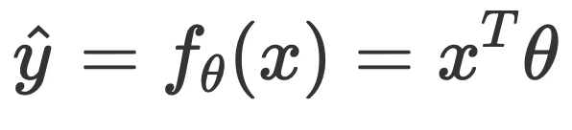
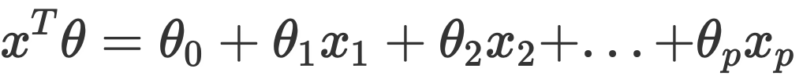
Linear Regression
In a linear regression model, our goal is to predict a quantitative variable (i.e., some real number) from a set of features.
Our output, or response, y, could be any real number.
We determined optimal model parameters by minimizing some average loss, and (sometimes) an added regularization penalty.
Remember, .

Slide 4
Classification
When performing classification, we are instead interested in predicting some categorical variable.
spam or ham
win or lose
disease or no disease

Slide 5
Classification
Binary classification: two classes.
Examples: spam / not spam.
Our responses are either 0 or 1.
Our focus today.
Multiclass classification: many classes.
Examples: Image labeling (cat, dog, car), next word in a sentence, etc.
This is not the first time you are seeing classification!
k-Nearest Neighbors was a classification technique you learned in Data 8.
Won’t cover it in Data 100.

Slide 6
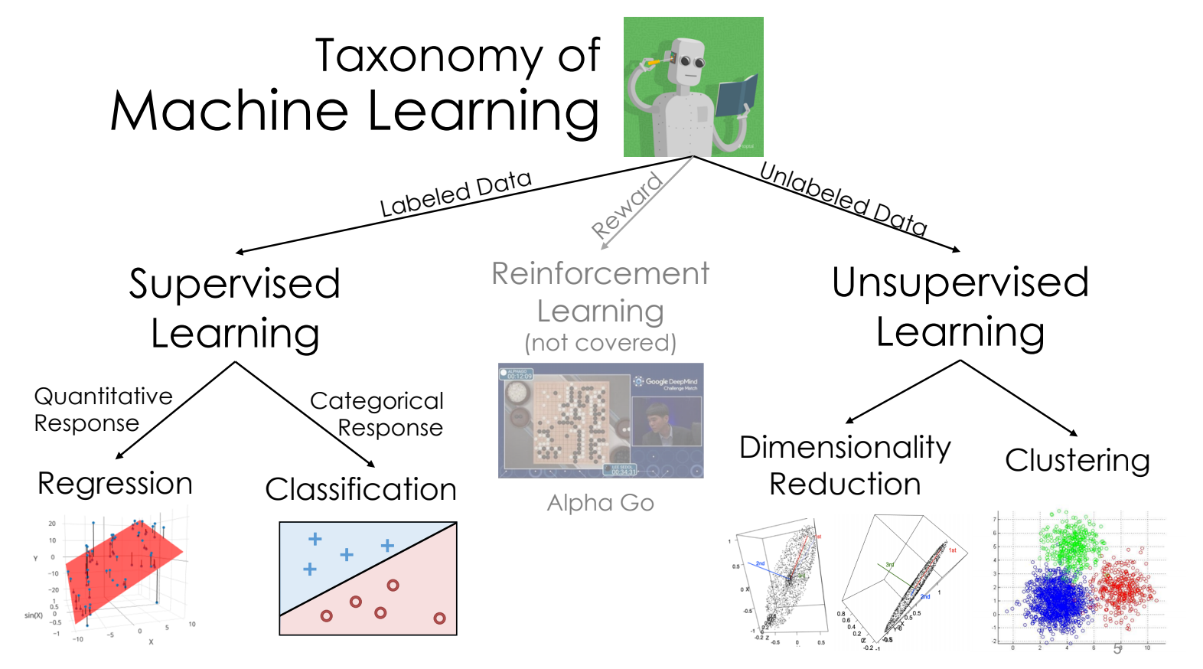
Machine learning taxonomy
Regression and Classification are both forms of supervised learning.
Logistic regression, is mostly used for classification, even though it has “regression” in the name.
from Joseph Gonzalez

Slide 7
Deriving the logistic regression model
In this section, we will mostly work out of the lecture notebook.

Slide 8
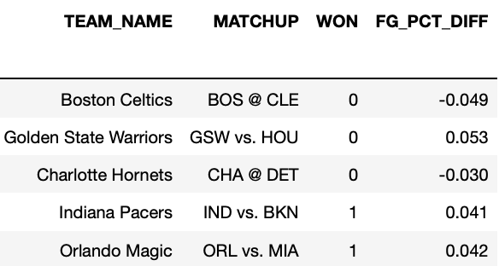
Example dataset
In this lecture, we will primarily use data from the 2017-18 NBA season.
Goal: Predict whether or not a team will win, given their FG_PCT_DIFF.
This is the difference in field goal percentage between the two teams.
Positive FG_PCT_DIFF: team made more shots than the opposing team.
1s represent wins, 0s represent losses.

Slide 9
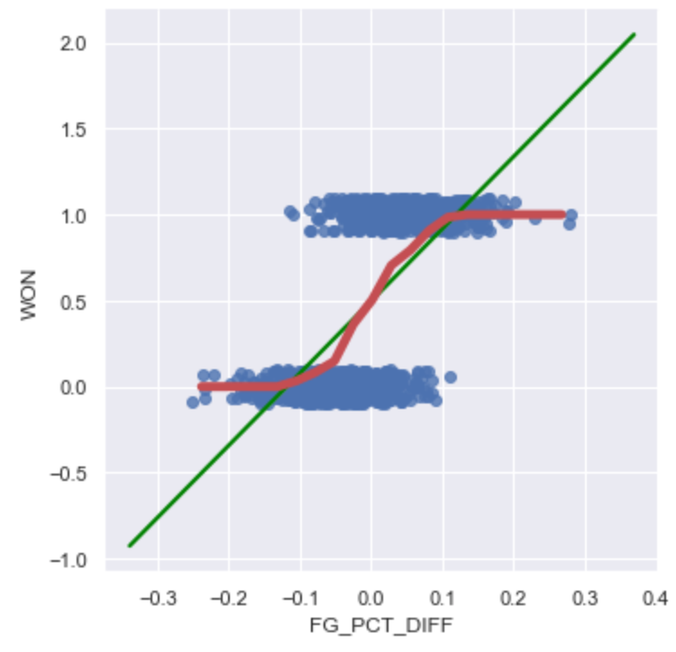
Graph of averages
When defining the simple linear regression model, we binned the x-axis, and took the average y-value for each bin, and tried to model that.
Doing so here yields a curve that resembles an s.
Since our true y is either 0 or 1, this curve models the probability that WON = 1, given FG_PCT_DIFF.
WON = 1 means “belong to class 1”.
Our goal is to model this red curve as best as possible.

Slide 10

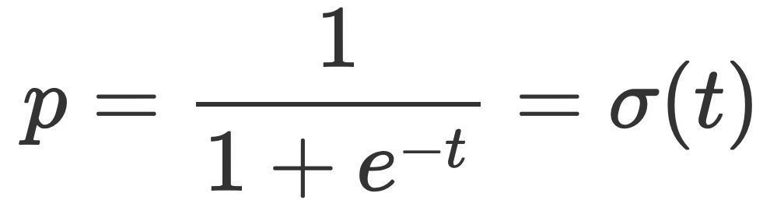
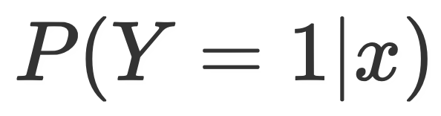
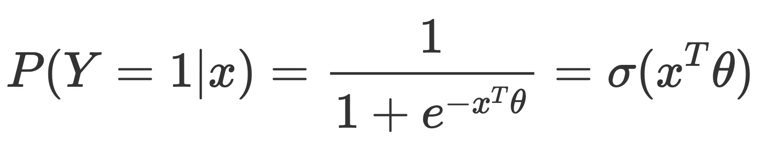
Arriving at the logistic regression model
We know how to model linear functions quite well.
We can substitute , since t was just a placeholder.
p represents the probability of belonging to class 1.
We are modeling .
Putting this all together:
Looks just like the linear regression model, with a 𝞼( ) wrapped around it.
We call logistic regression a generalized linear model, since it is a non-linear transformation of a linear model.

Slide 11
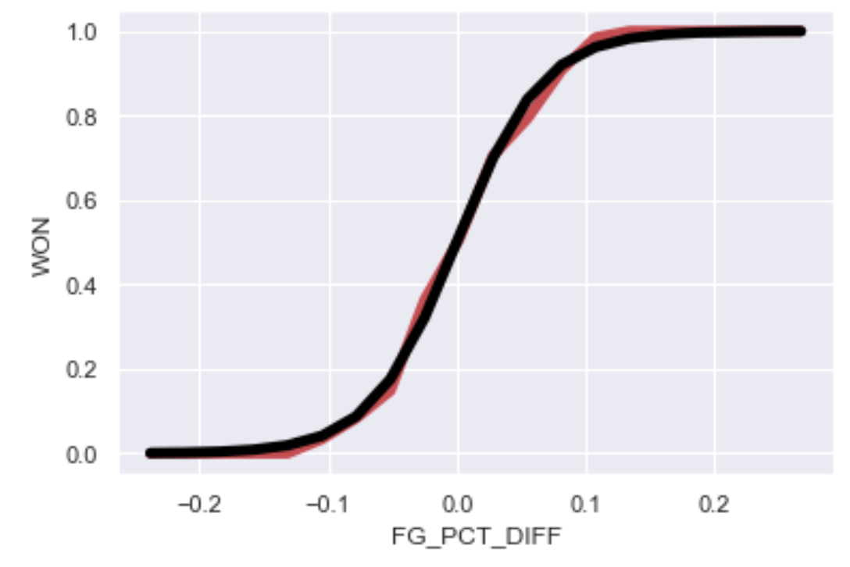
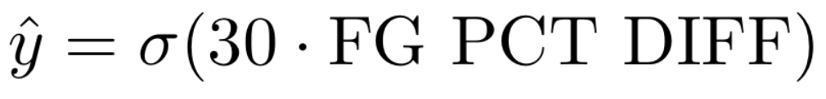
Arriving at the logistic regression model
* no transposes here, since we only looked at one feature (without an intercept term!)
In red:
Empirical graph of averages
In black:

Slide 12
Logistic regression

Slide 13
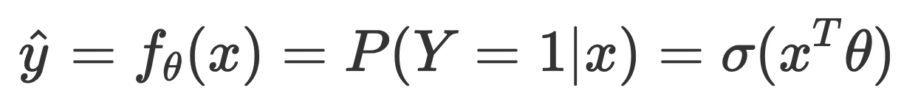
Linear vs. logistic regression
In a linear regression model, we predict a quantitative variable (i.e., some real number) as a linear function of features.
Our output, or response, y, could be any real number.
In a logistic regression model, our goal is to predict a binary categorical variable (class 0 or class 1) as a linear function of features, passed through the logistic function.
Our response is the probability that our observation belongs to class 1.
Haven’t yet done classification!

Slide 14
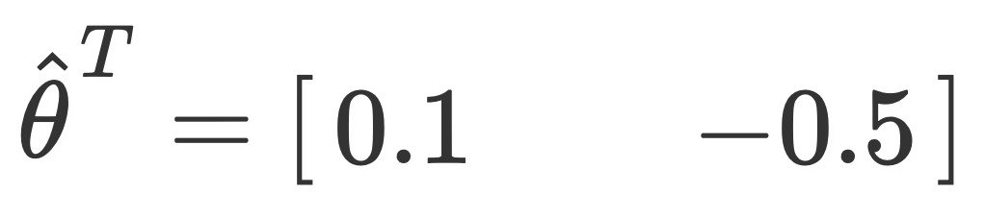

Example calculation
Suppose I want to predict the probability that LeBron’s shot goes in, given shot distance (first feature) and # of seconds left on the shot clock (second feature).
I fit a logistic regression model using my training data, and somehow compute
Under the logistic model, compute the probability his shot goes in, given that
He shoots it from 15 feet.
There is 1 second left on the shot clock.

Slide 15
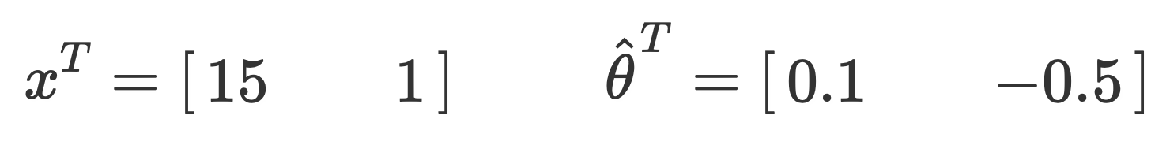
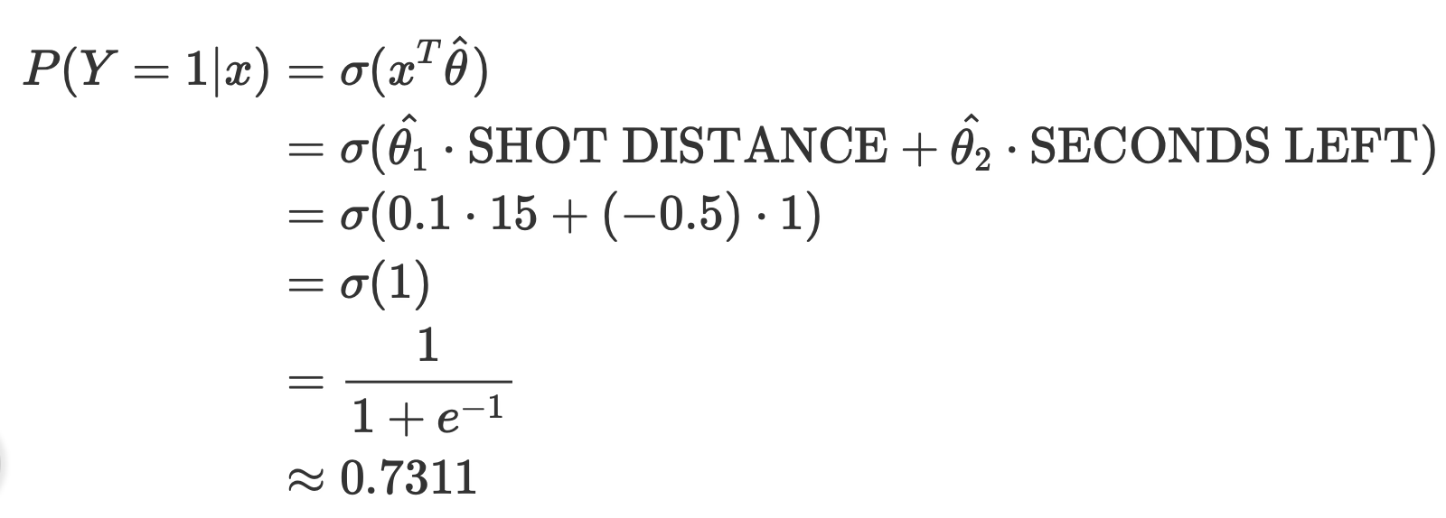

Example calculation (solution)
An explicit expression representing our model.

Slide 16
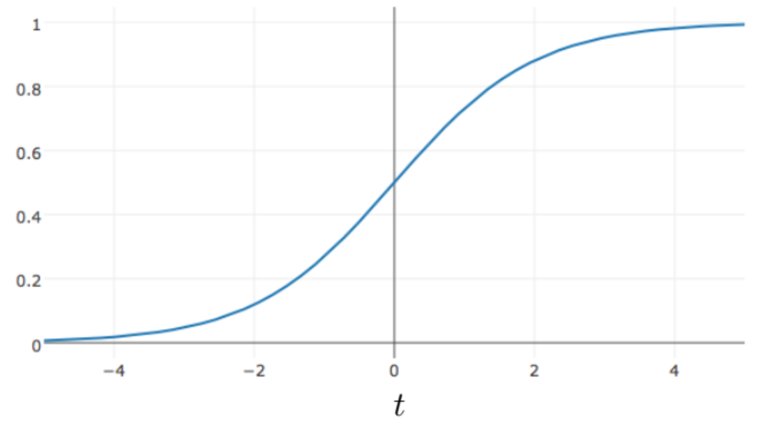
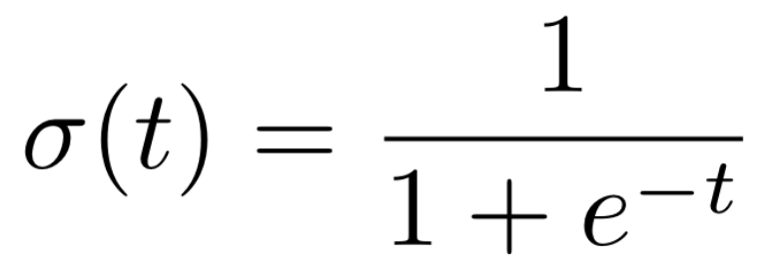

Properties of the logistic function
The logistic function is a type of sigmoid, a class of functions that share certain properties.
Its output is bounded between 0 and 1, no matter how large t is.
Fixes an issue with using linear regression to predict probabilities.
We can interpret it as mapping real numbers to probabilities.

Slide 17
Cross-entropy loss

Slide 18
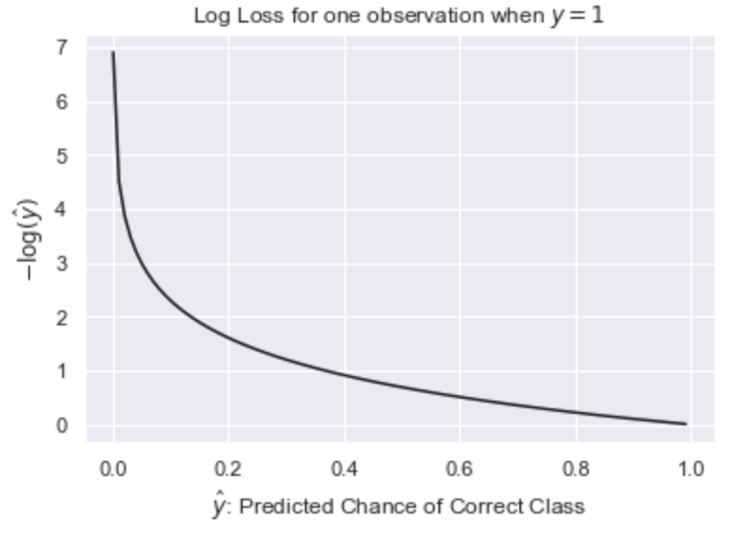
Log loss
Consider this new loss, called the (negative) log loss, for a single observation when the true y is equal to 1.
We can see that as our prediction gets further and further from 1, the loss approaches infinity

Slide 19

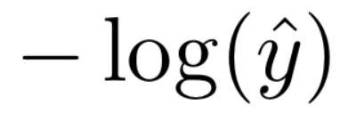
Log loss
Let’s look at some losses in particular:
1 | 0
0.8 | 0.25
0.4 | 1
0.05 | 3
0 | infinity!
Note: The logistic function never outputs 0 or 1 exactly, so there’s never actually 0 loss or infinite loss.

Slide 20
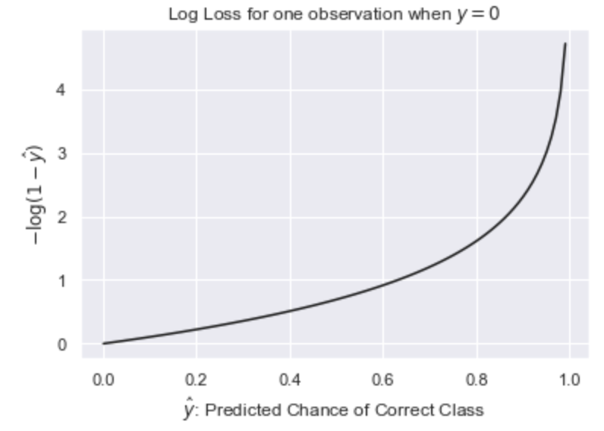
Log loss
So far, we’ve only looked at log loss when the correct class was 1.
What if our correct class is 0?
If the correct class is 0, we want to have low loss for values of close to 0, and high loss for values of close to 1. This is achieved by just “flipping” the plot on the left!

Slide 21
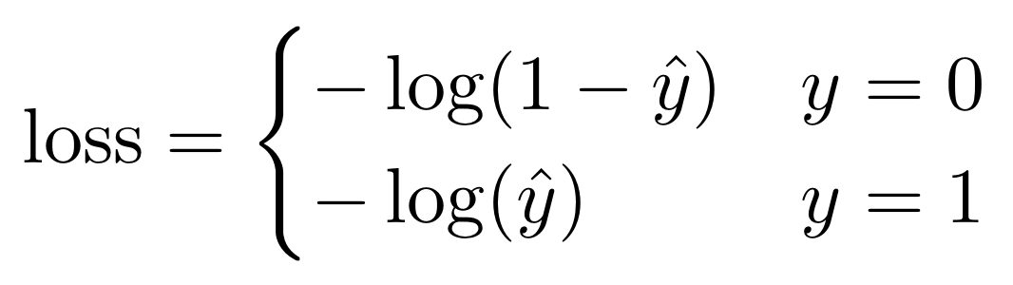
Cross-entropy loss
We can combine the two cases from the previous slide into a single loss function:
This is often written unconditionally as:
Note: Since y = 0 or 1, one of these two terms is always equal to 0, which reduces this equation to the piecewise one above.
We call this loss function cross-entropy loss (or “log loss”).

Slide 22
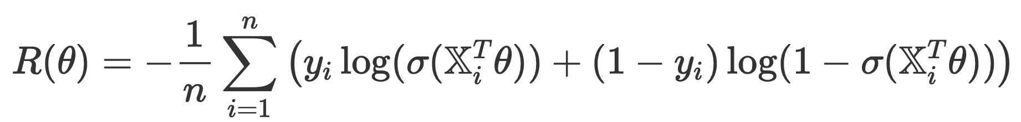
Mean cross-entropy loss
The empirical risk for the logistic regression model when using cross-entropy loss is then
Benefits over mean squared error for logistic regression:
Loss surface is guaranteed to be convex.
More strongly penalizes bad predictions.
Has roots in probability and information theory.

Slide 23

Modeling recipe
As per usual:
Choose a model.
Choose a loss (and, optionally, a regularization penalty).
Minimize empirical risk for the given model, loss, and regularization penalty (using an analytical solution, or numerical technique like gradient descent).
Cross-entropy loss is strictly better than squared loss for logistic regression.
Convex, so easier to minimize using numerical techniques.
Better suited for modeling probabilities.

Slide 24
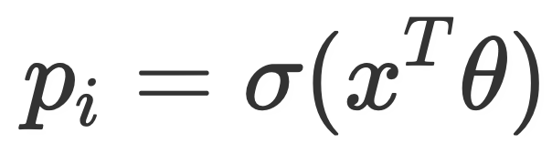
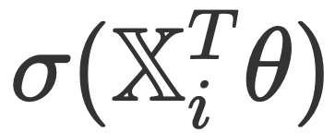
Cross-entropy loss
What does this have to do with logistic regression?
We have n observations (y1, y2, …, yn). Each is either 1 or 0.
Assume that each is independent of one another.
Can think of observation yi as the result of a coin toss with probability pi.
The output of our logistic regression model is our estimate for the probability that yi = 1.
Thus, we can use the above average loss, with .
This gives us the exact same expression for cross-entropy loss that we saw before!

